Slide 1
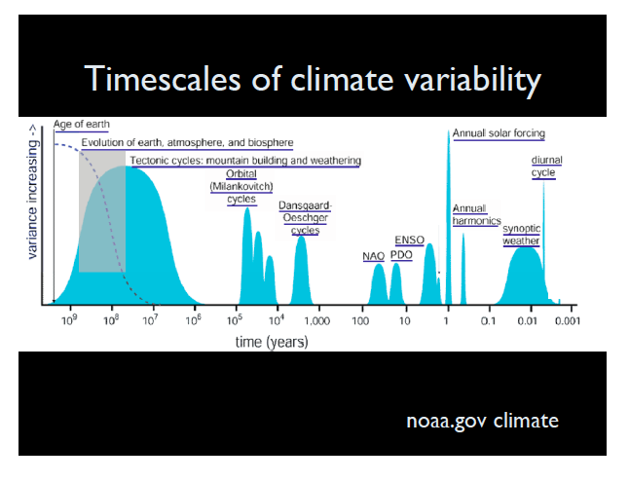

Slide 2
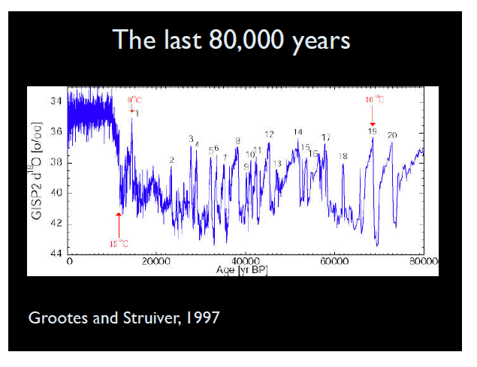

Slide 3
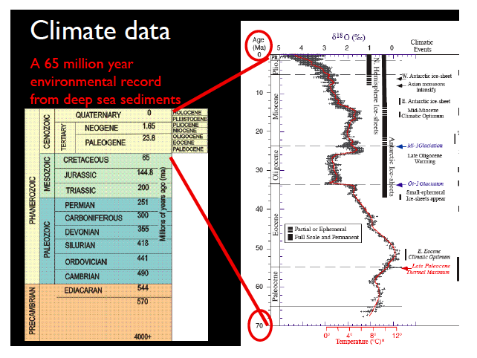
From lecture of Pam Martin (IUPUI and MCRN) at NCAR 2010

Slide 4
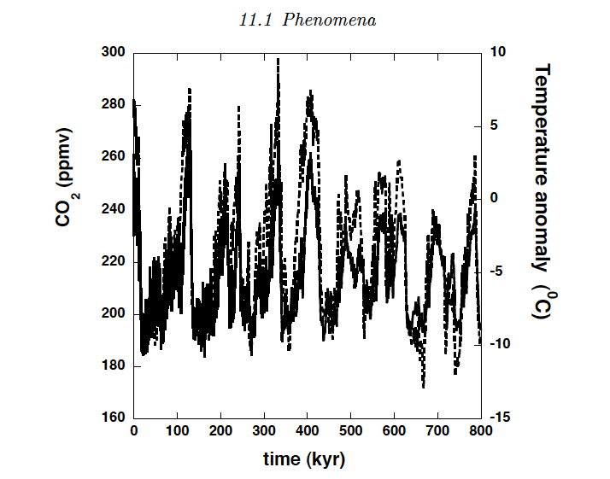
Key event: MPT (Mid Pleistocene Transition):
Before (around) 700 kyr BP: 100 kyr period
After: 41 kyr period

Slide 5
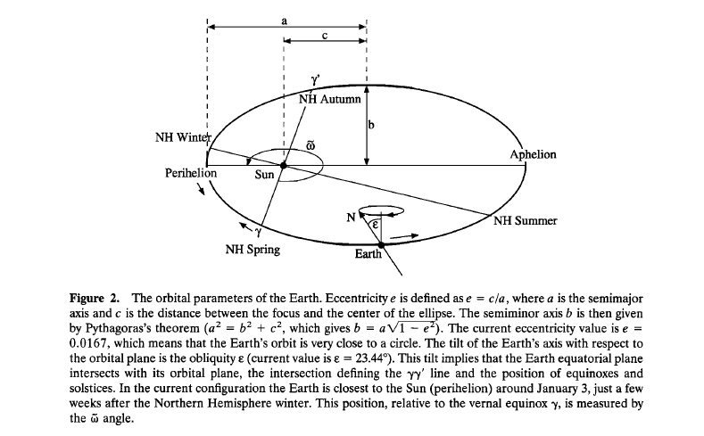
Milankovitch Cycles (the “null” hypothesis”)

Slide 6
EBM BM RMA PM ICM GCM CM ESM
Energy Balance Model

Slide 7
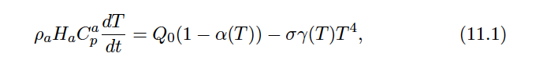
Energy Balance
Dijkstra (p 275):

Slide 8

Incoming and outgoing radiation
Incoming radiation =
Outgoing radiation =

Slide 9
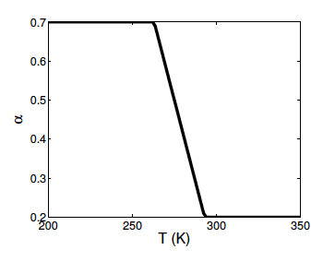
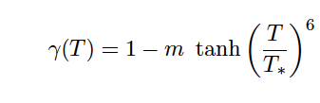
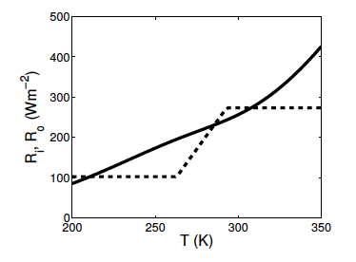
Graph of albedo: Sellers (1969)

Slide 10
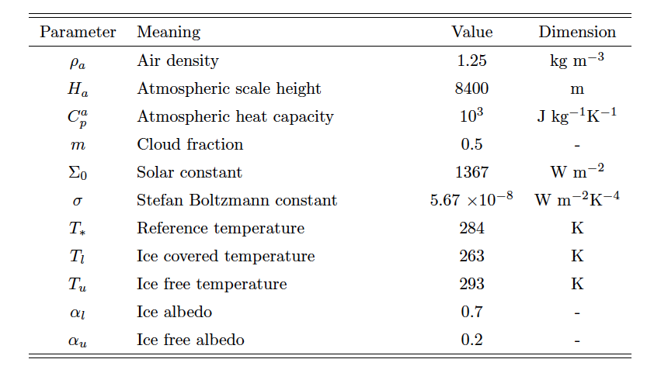

Slide 11
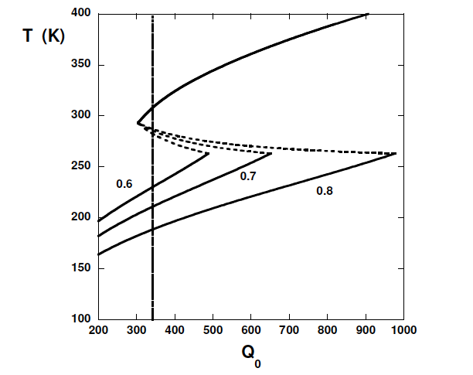

Slide 12
FEEDBACKS
Growth away from (positive), or decay toward (negative), an equilibrium due to a “feedback” loop
Ice-albedo feedback
Height-mass balance feedback
Load-accumulation feedback
Precipitation-temperature feedback

Slide 13
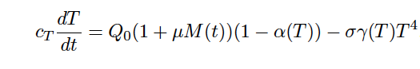
Milankovitch Forcing

Slide 17
If, for each s the “frozen” system has an attracting equilibrium at x=x(s), then the full system has a tube around the set
That is positively invariant relative to
Note: if forcing is periodic, can get an attracting periodic orbit

Slide 18
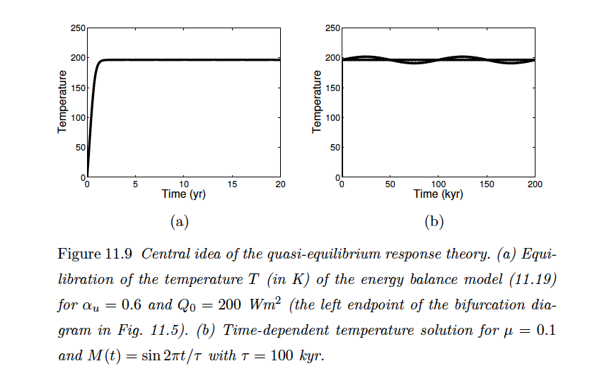
Dijkstra: Quasi-Equilibrium Theory

Slide 19
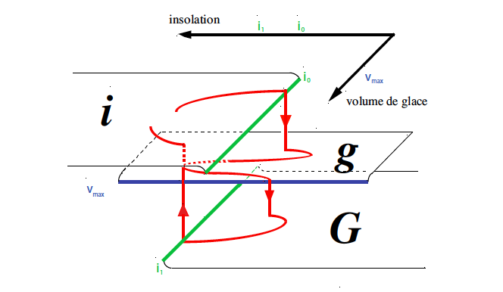
Paillard Model
Rules:

Slide 20
